Slide 1
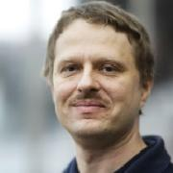
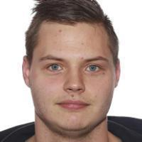
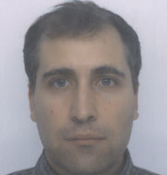
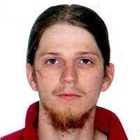
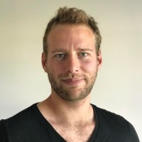
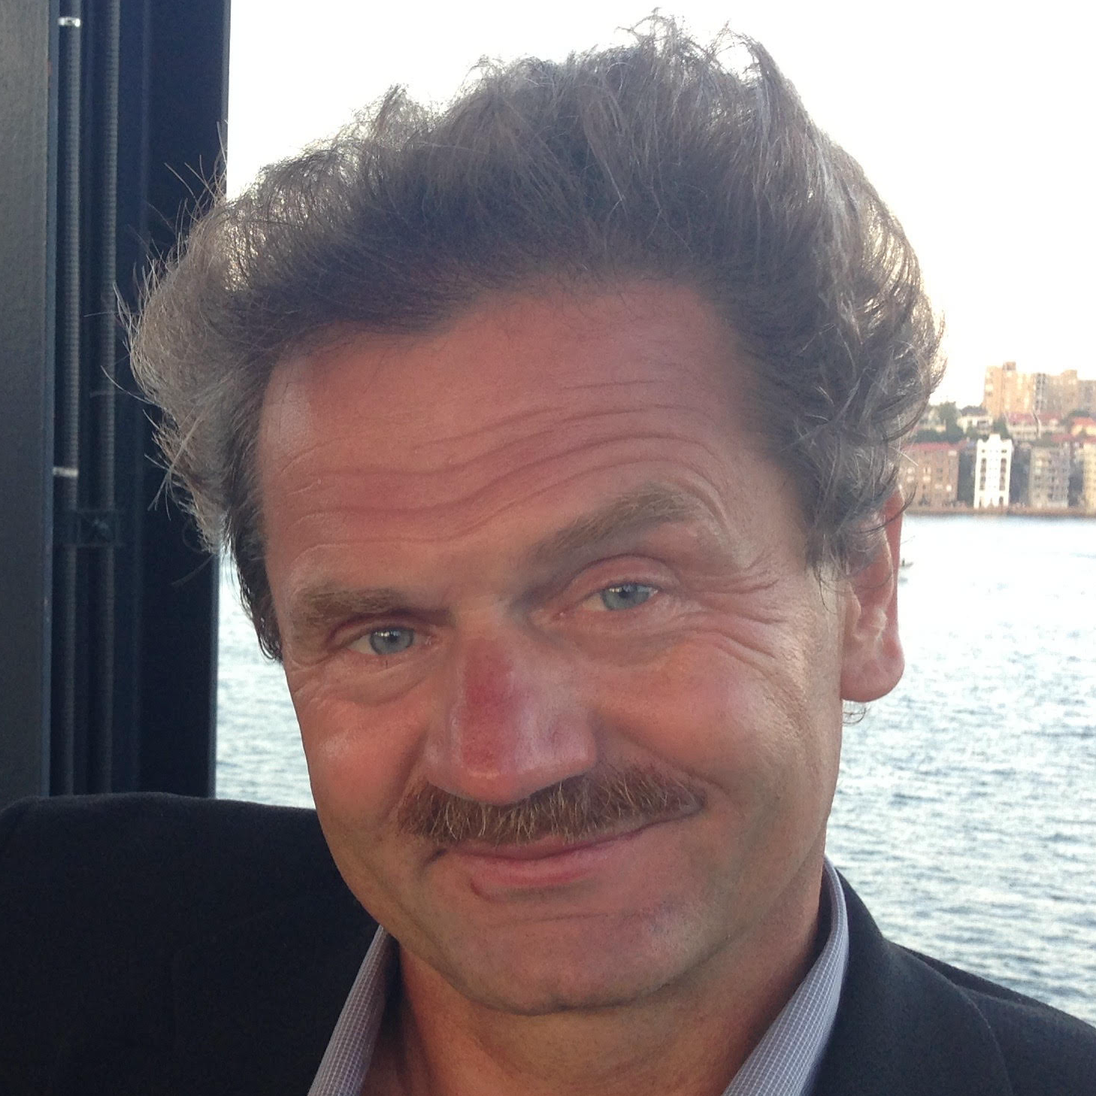
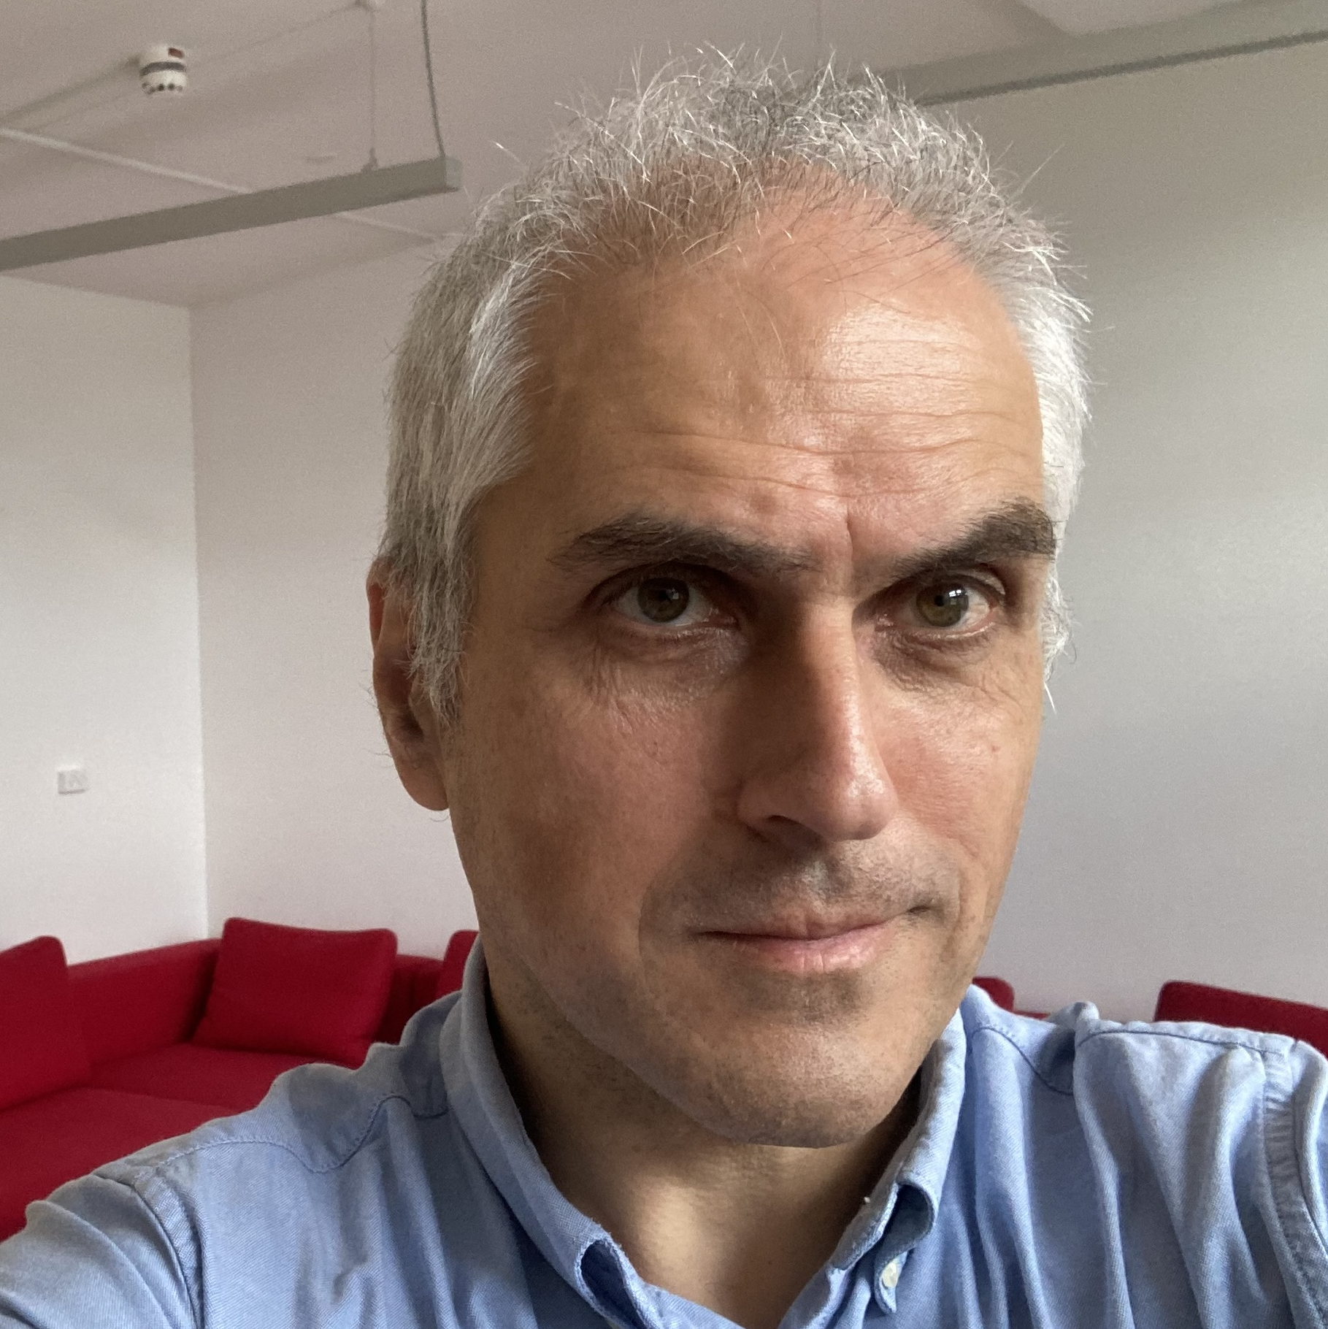
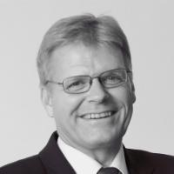
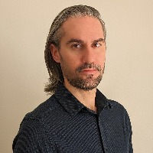
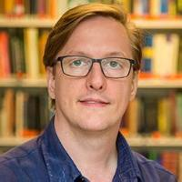
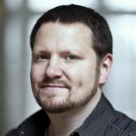
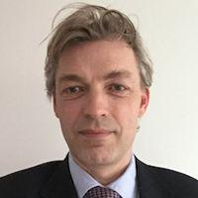
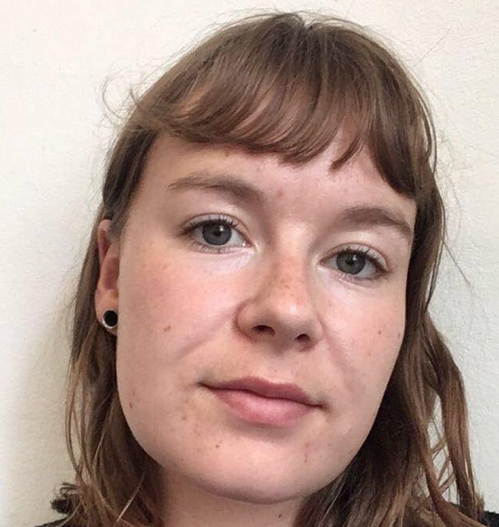
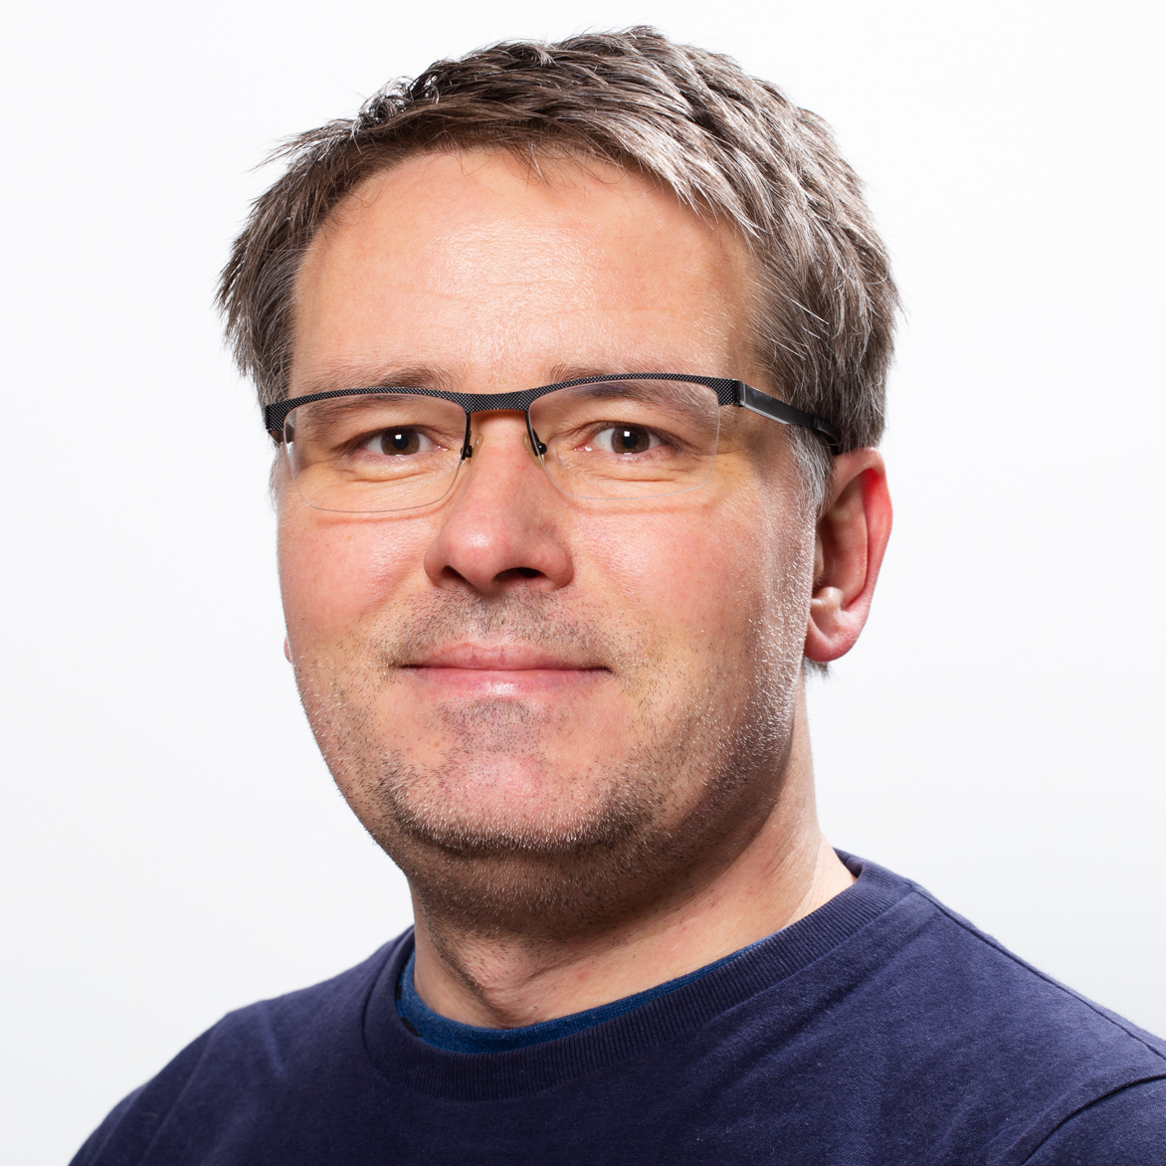
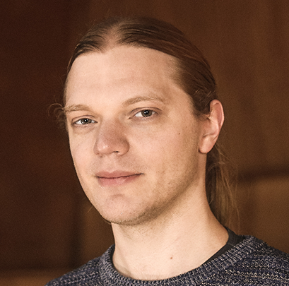
University of copenhagen
Department of computer science
PLTC Section Members
Andrzej Filinski
Associate Professor
01-0-S10
Carl-Johannes Johnsen
Postdoc
01-0-S06
Cosmin Eugen Oancea
Associate Professor
01-0-S05
David Gray Marchant
Postdoc
01-0-S06
Franciszek Olaf Zdyb
Research Assistant
01-0-S07
Fritz Henglein
Professor
01-0-S09
Hans Hüttel
Associate Professor
01-0-S20
Henrik Bjørn Axelsen
PhD Fellow
01-0-S25
Ivan Luiz Picoli
Postdoc
01-0-S25
James Emil Avery
Associate Professor
01-0-S06
Ken Friis Larsen
Associate Professor
01-0-S21
Martin Elsman
Professor
01-0-S15
Matilde Mouritsen Broløs
PhD Fellow
01-0-S25
Michael Kirkedal Thomsen
Associate Professor
01-0-S16
Mikkel Kragh Mathiesen
Postdoc
01-0-S07

Slide 2

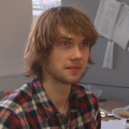
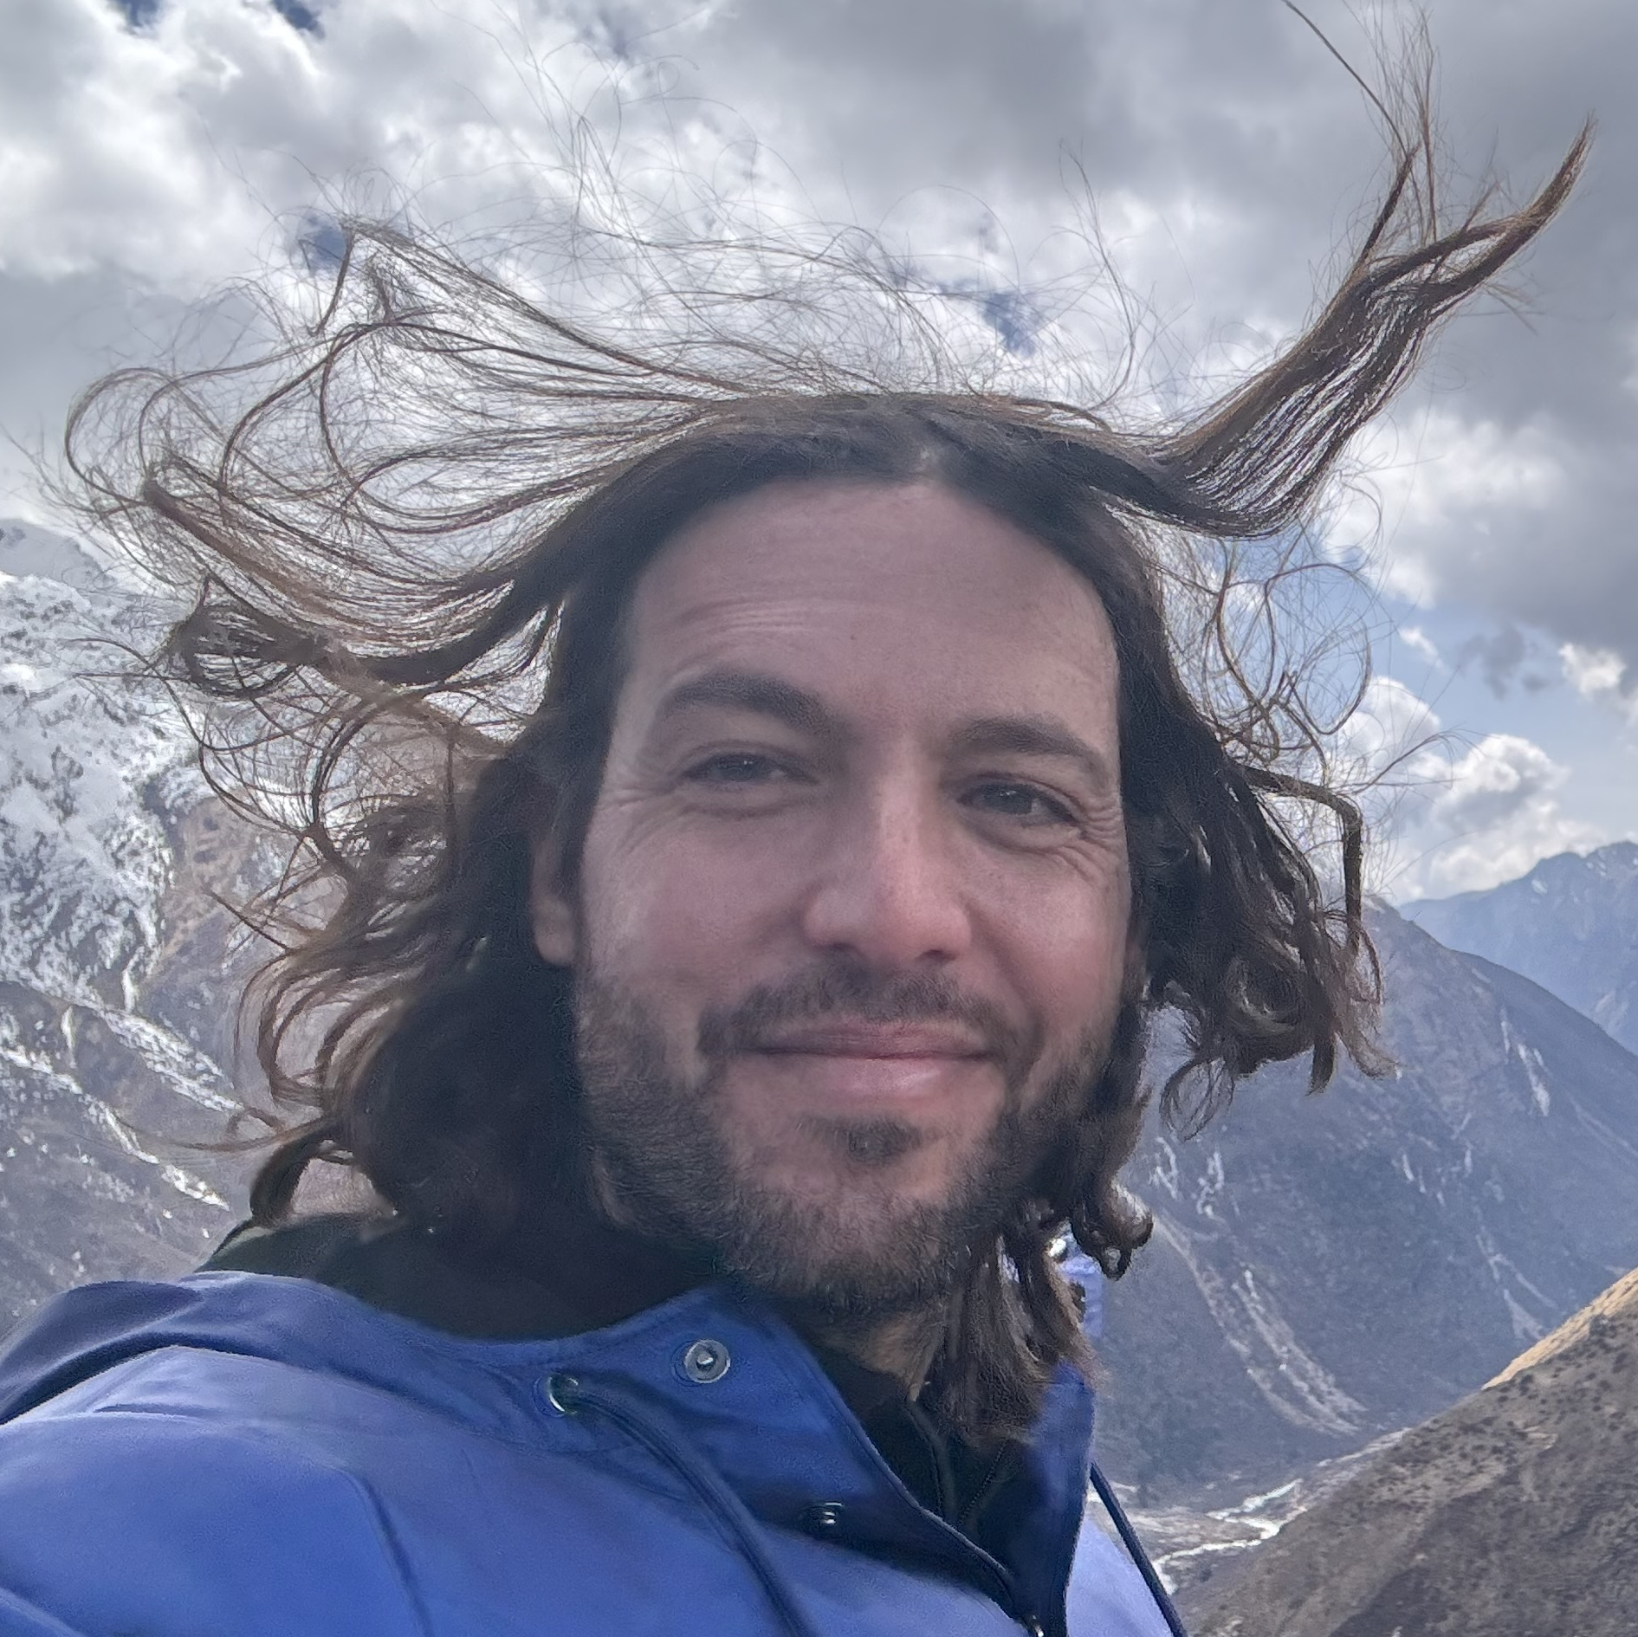
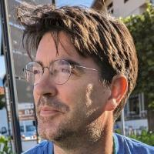


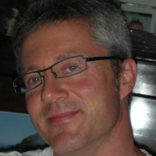
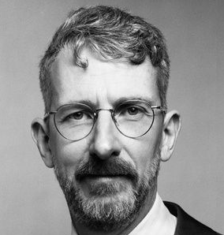
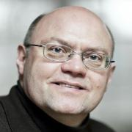
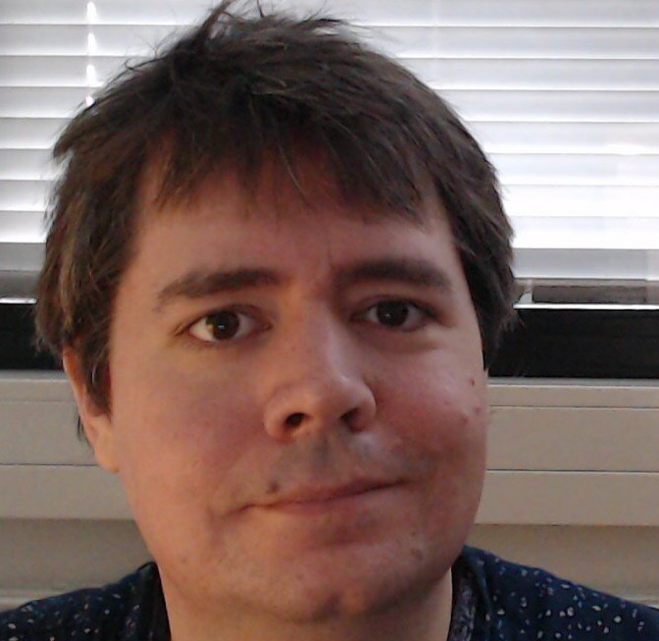
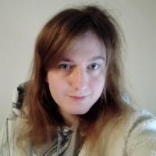
Nikolaj Hey Hinnerskov
PhD Fellow
01-0-S17
Ola Rønning
Postdoc
01-0-S07
Omry Ross
Associate Professor
01-0-S12
Philippe Bonnet
Professor
01-0-S03
Robert Glück
Professor
01-0-S23
Robert Schenck
PhD Fellow
01-0-S17
Thomas Philip Jensen
Professor
01-0-S16
Thomas Wim Hamelryck
Professor
01-0-S12
Torben Ægidius Mogensen
Associate Professor
01-0-S08
Troels Henriksen
Assistant Professor
01-0-S14
HPC
William Henrich Due
PhD Fellow
01-0-S25
01-0-S18
01-0-S19
University of copenhagen
Department of computer science

